Slide 1




Weekly report: Storage System
10th week – 11th Presentation
Date: 02/12/2025
Supervisor: Dr. Laurence Alhrshy
Group members : Dr. Doha Khaled Jdeed , Mohamed Ahmed
02/12/2025
Mohamed Ahmed
Storage System Team/ Optimus Syria

Slide 2
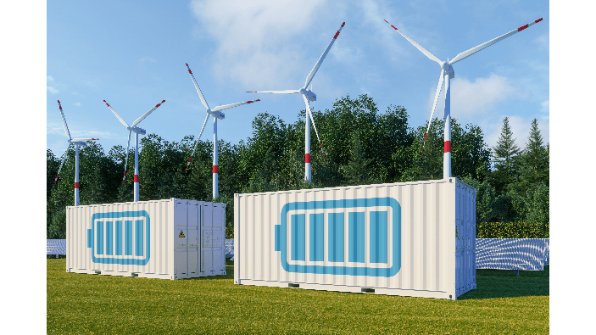
Content
Why use Simulink
Simulink Model
Simulation Scenarios
References
avaada.com/advantages-of-wind-energy/ 30\11\2025
02/12/2025
2
Mohamed Ahmed
Storage System Team/ Optimus Syria

Slide 3
Why use Simulink
Verify the developed storage concept
Model the system behavior: wind turbine + battery + grid
Simulate different scenarios: battery charge/discharge, peak shaving, curtailment, grid faults
^{Check adequate battery sizing}
Evaluate grid service performance
02/12/2025
Mohamed Ahmed
Storage System Team/ Optimus Syria

Slide 4
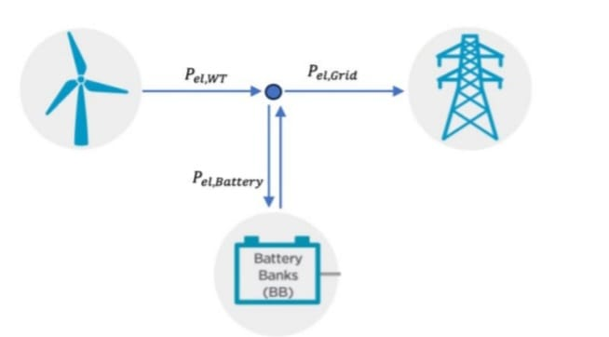
Simulink Model
Power from the wind turbine is directed either to battery storage or to the grid
• A control system decides the proper routing of power.
  Decision Criteria:
  Power signal: from the wind turbine
  State of Charge (SoC): battery
  Curtailment signal: grid
  Peak shaving: grid
  Grid fault: grid
Optimus Shakti. 30\11\2025
02/12/2025
4
Mohamed Ahmed
Storage System Team/ Optimus Syria

Slide 5
Simulation Scenarios
  Scenario 1:
Criteria: | Yes | No
Power signal
State of charge in operational range (0.2<Soc>1)
Curtailment signal
Peak shaving
Grid fault
Description: Generated electric power directly flow to the power system. The battery is neither charging nor discharging
Scenario 2:
Criteria: | Yes | No
Power signal
State of charge in operational range (0.2<Soc>1)
Curtailment signal
Peak shaving
Grid fault
Description: The wind turbine deliver the generated power to the power system , while the remaining curtailed power charges the battery.
02/12/2025
5
Mohamed Ahmed
Storage System Team/ Optimus Syria

Slide 6
Simulation Scenarios
Scenario 3:
Criteria: | Yes | No
Power signal
State of charge in operational range (0.2<Soc>1)
Curtailment signal
Peak shaving
Grid fault
Description: The generated power cannot meet the high grid demand, so the remaining power for the peak shaving is provided by the battery.
Scenario 4:
Criteria: | Yes | No
Power signal
State of charge in operational range (0.2<Soc>1)
Curtailment signal
Peak shaving
Grid fault
Description: During a grid fault, the generated power is redirected entirely to the battery, in order to support gradually slow down the wind turbine and smooth the shutdown.
02/12/2025
6
Mohamed Ahmed
Storage System Team/ Optimus Syria

Slide 7
Simulation Scenarios
Scenario 5:
Criteria: | Yes | No
Power signal
State of charge in operational range (0.2<Soc>1)
Curtailment signal
Peak shaving
Grid fault
Description: When the wind turbine is not generating power, there will not be a power flow nether to the power system nor the battery. The grid behavior becomes irrelevant in this scenario.
Scenario 6:
Criteria: | Yes | No
Power signal
State of charge in operational range (0.2<Soc>1)
Curtailment signal
Peak shaving
Grid fault
Description: If the battery SoC is outside the operational range, the battery cannot be charged (SoC>1) or discharged (SoC<0.2). Curtailment requires aerodynamic turbine reduction; peak shaving and grid support are restricted accordingly.
02/12/2025
7
Mohamed Ahmed
Storage System Team/ Optimus Syria

Slide 8
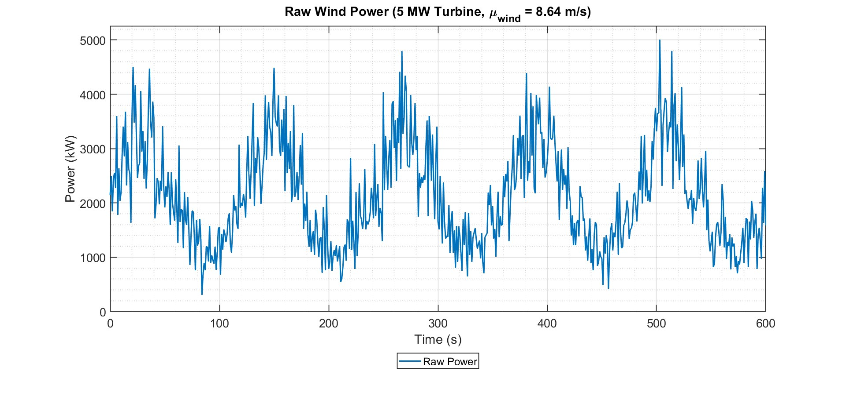
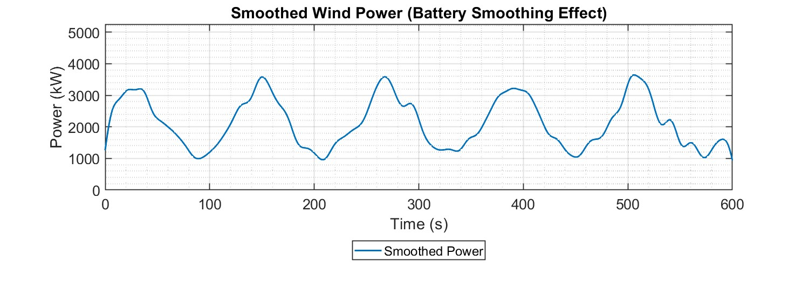
Grid Services: Steadying the power infeed
•High frequented fluctuations of the generated power will be smoothed by battery storage .
•Steadying of infeed power by charging and discharging of battery storage.
•Low pass filter will supress high frequencies and moving average filter high ramps.
Picture: own creation (30.11.2025)
Picture: own creation (30.11.2025)
02/12/2025
8
Mohamed Ahmed
Storage System Team/ Optimus Syria

Slide 9
Next Presentation
Cable Calculations
Grid/Turbine Services
02/12/2025
9
Mohamed Ahmed
Storage System Team/ Optimus Syria
Notes:
Add references

Slide 10
Next Presentation
•1.https://www.mdpi.com/1996-1073/14/9/2556?utm_source
•https://syrianrenewables.com/
02/12/2025
10
Mohamed Ahmed
Storage System Team/ Optimus Syria
Notes:
Add references

